Slide 1
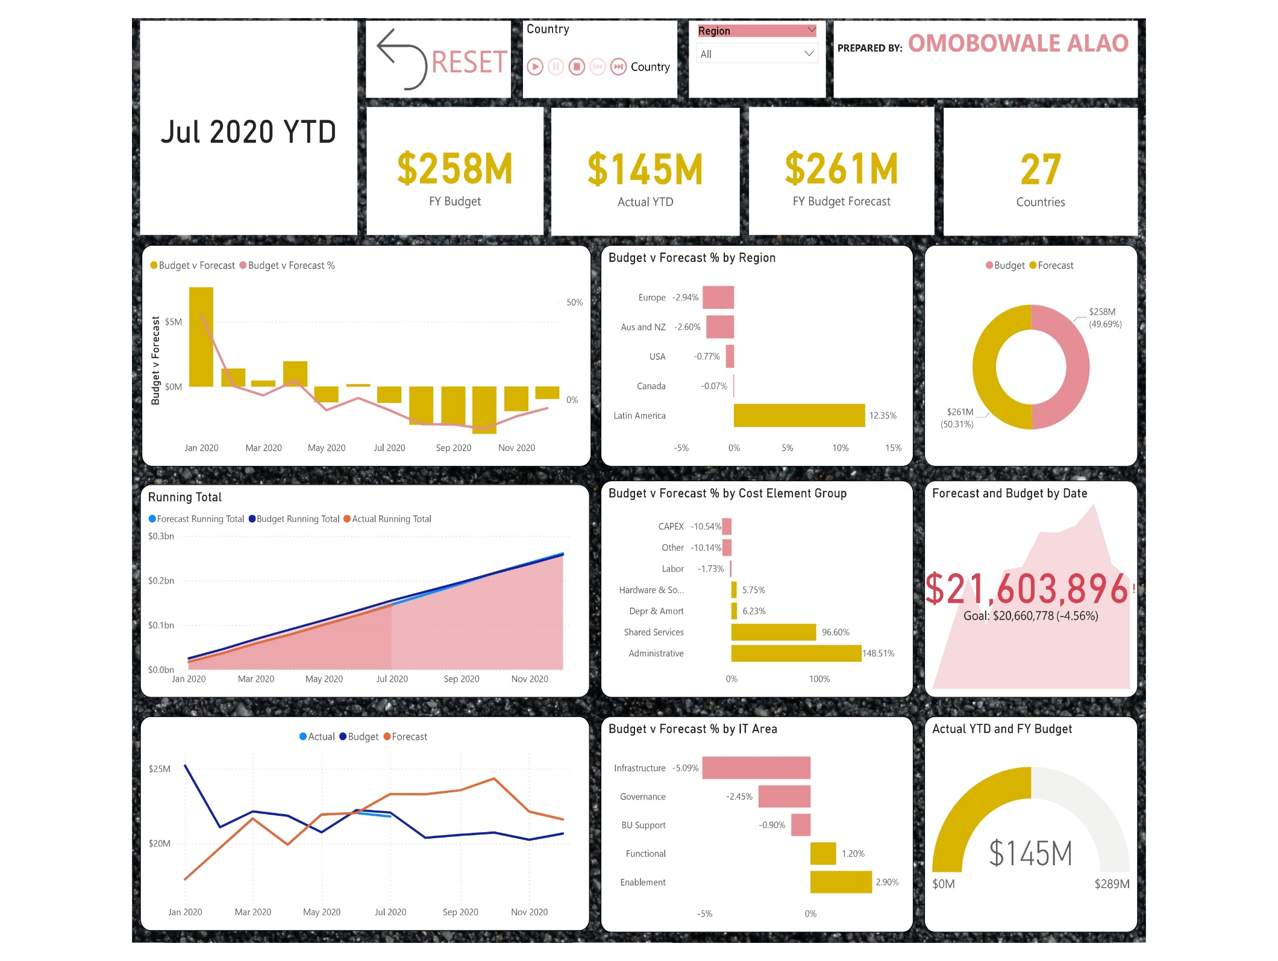

Slide 2
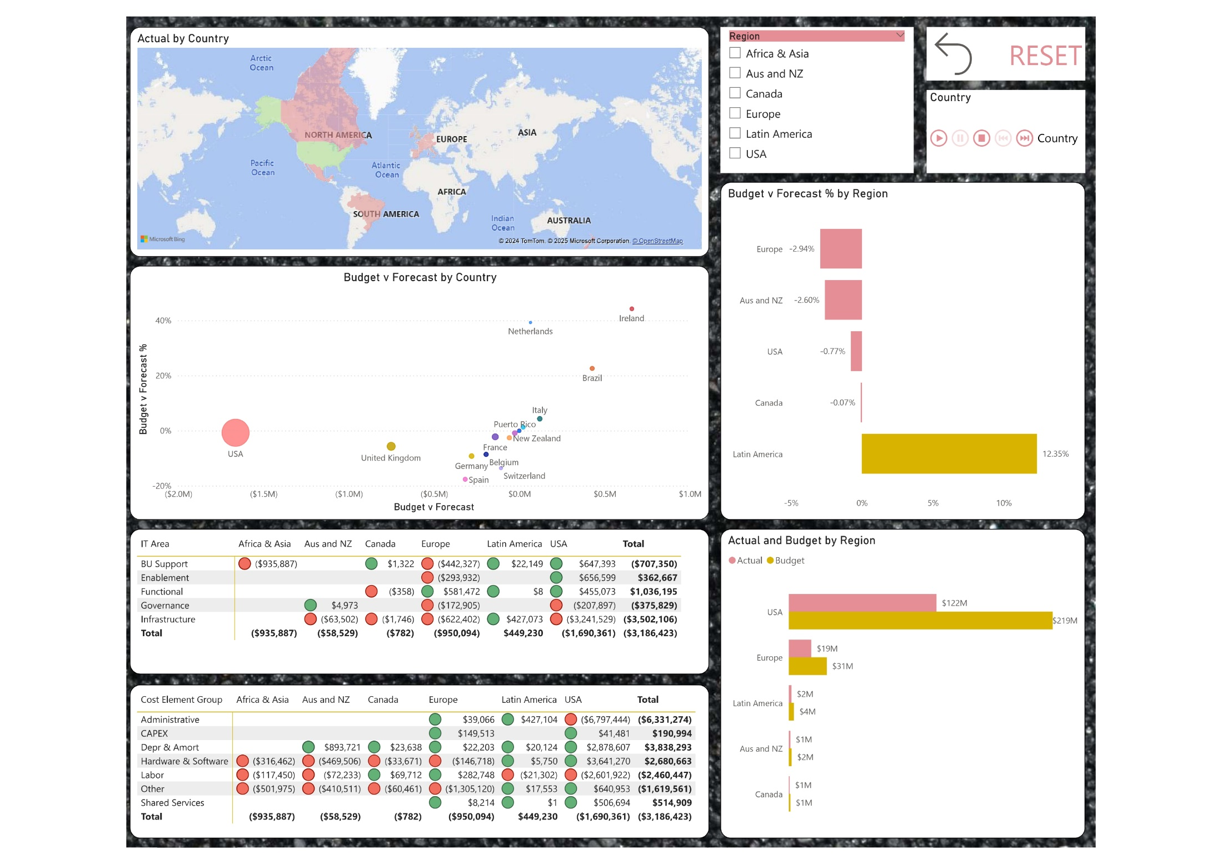

Slide 3
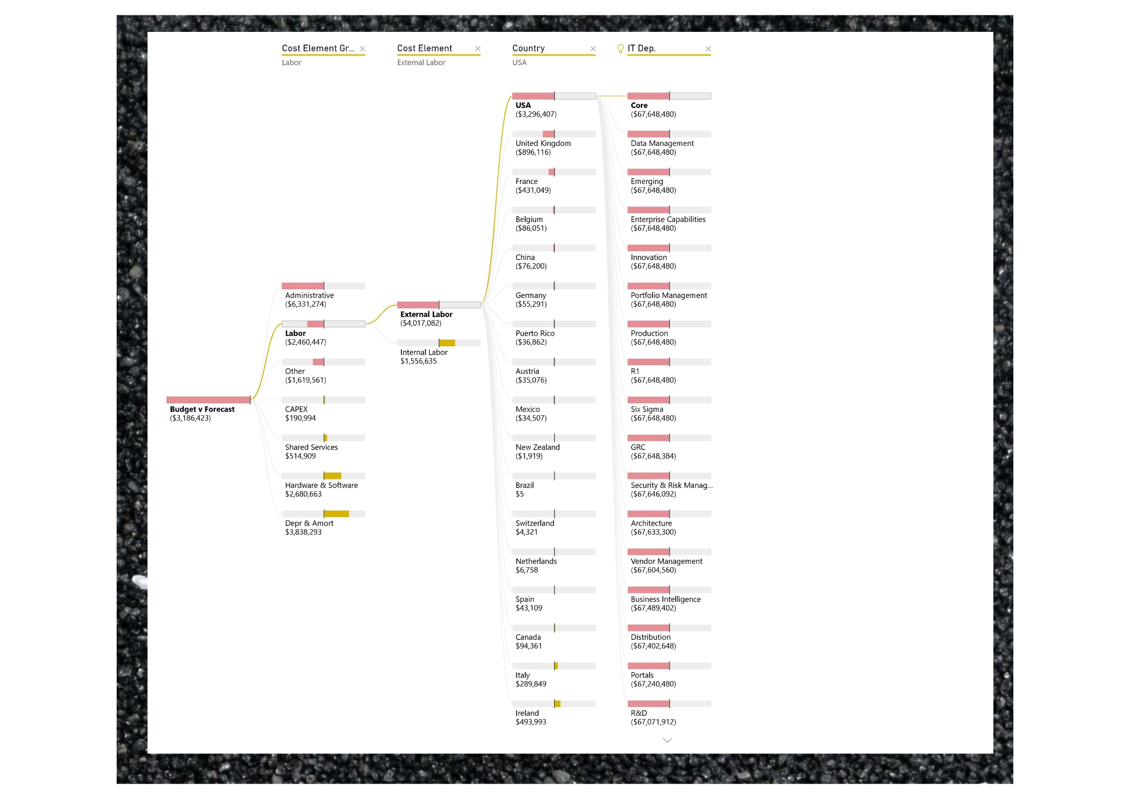

Slide 4

PREPARATION
Understand Context
A global company, Home Options Group, is interested in understanding the key factors driving IT department costs across regions, see how actual spending compares to the budget and forecast, and what strategies can be implemented to reduce costs while maintaining quality.
Project Plan
As the data analyst, my task is to investigate the costs associated with maintaining the IT department by comparing actual performance against budgeted expenditures and forecast. I will analyse regional cost trends, identify key drivers of expenses, and assess factors like labour, technology, and outsourcing. Based on this analysis, I will provide actionable recommendations for cost reduction strategies that maintain or improve service quality across regions
Cleanse Data
The currency was not provided. Since the parent company is in the United States of America, we're assuming the US Dollars ($) as the currency. In the real scenario, this needs to be clarified with the business.
A Calendar Table was added to enhance our time-related analysis.
Relationships were created among the Calendar, Dimension and Fact tables.
Measures were used to calculate the Budget Running Total, Budget v Forecast, Budget v Forecast %, Actual Running Cost, Forecast Running Total, and Budget Running Total.
A measure, YTD Month, was created to indicate the YTD period based on the latest available data in the report.
The data was transformed in Power Query to identify any missing values or formatting errors. Since no issues were found, the data is now ready for analysis.
Data
The data I will be working with consists of twelve (12) months' worth of Budget and Forecast data, along with Year-to-Date (YTD) Actual data up to July 2020.

Slide 5

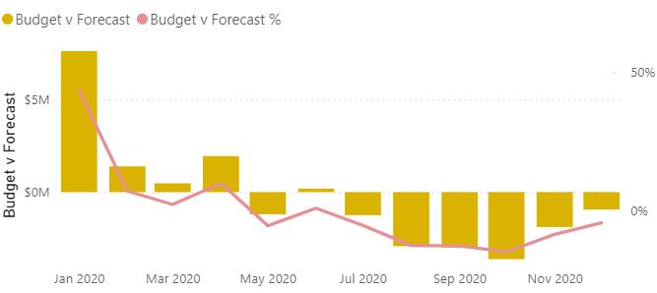
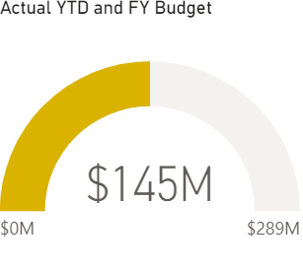
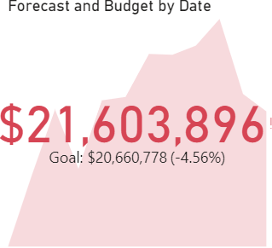
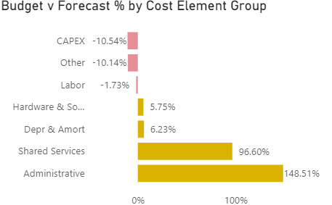
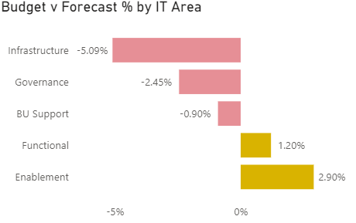
Headline
KEY INSIGHTS
For the Budget v Forecast % by Cost Element Group and IT Area, a positive percentage shows that Budget is expected to be higher than the Forecast while a negative percentage shows that Budget is expected to be lower than Forecast.
A positive percentage for Administrative costs, Shared Services, Depreciation and Amortisation suggest that the actuals are expected to be above the budgeted amount. The company expects to spend more on these than initially planned, which could be due to unforeseen expenses, increased usage, or higher-than-expected costs in these areas, similar for Functional and Enablement in IT area. Home Options Group need to dive into each category to understand the specific reason behind these variances and if the expected cost could be minimized.
Budget vs. Forecast by Month shows how well the company’s cost budget aligns with its forecasted needs. There was an instance of overbudgeting in January, but the company expects to spend more than initially forecasted starting in August.
As of Year-to-Date, the actual spending of $145 million is approximately 93.1% of the YTD budget of $155 million indicating that the company is currently under budget, however, it will need to minimize or keep spending trend for the remaining months to avoid meeting up or exceeding the full-year budget of $289 million.
The KPI chart suggests that the forecasted cost of $21.6 million is expected to exceed the budgeted cost of $20.7 million by year-end, which is undesirable. The company will need to implement cost-saving strategies to prevent this outcome by the end of the year.

Slide 6
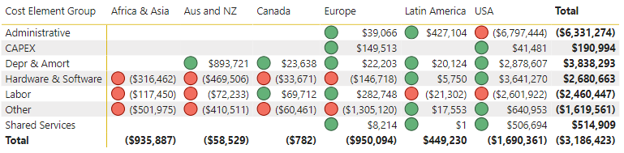
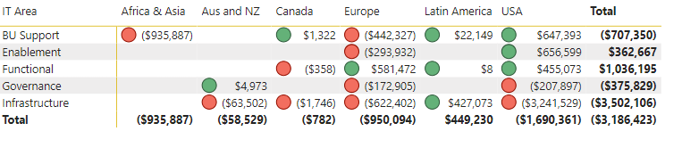
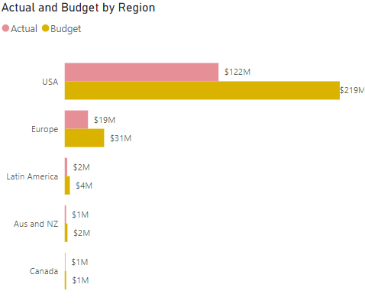
Regions
KEY INSIGHTS
As of July, year-to-date (YTD), the USA has achieved $122 million of its fiscal year (FY) budget of $219 million, whereas Canada has reached $526,000 of its $1.1 million budget.
Having achieved 55.7% ($122m out of $219m) of its FY cost budget, USA has incurred a significant portion of its budgeted costs. If this trend continues, they might stay within or potentially exceed their budget by year-end, depending on future expenditures.
Having achieved only 47.8% ($526k out of $1.1m) of its cost budget, Canada has kept its costs relatively low. This could be a sign of effective cost management, or it could indicate under-spending in areas that may need attention.
Budget vs. Forecast by Cost Element Group/IT Area and Country assesses whether the company's cost projections are aligned with the budget, allowing for better financial planning and adjustments throughout the period.
Positive outcome, depicted by green icons, indicates that the company has allocated more money for costs than what is expected (overestimation) while a negative outcome, depicted by the red icons, indicates that the company expects to spend more than what was originally budgeted, which signals the need for cost control in these cost element groups and areas.
Notably, the USA needs to find ways to minimize administrative and labour costs.

Slide 7
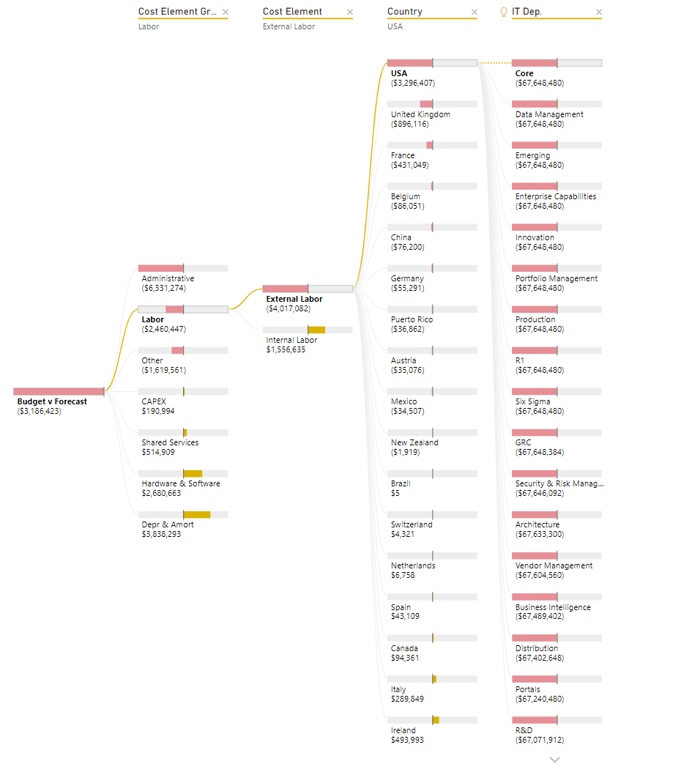
Decomposition
KEY INSIGHTS
The decomposition tree reveals that the Administrative and Labour cost elements have the most significant negative impact on the cost budget. Upon further analysis, External labour accounts for the higher negative variance between budget and forecast at $4,017,082, compared to $1,556,635 for internal labour. The USA is experiencing the largest negative variance for these costs

Slide 8

CONCLUSION
Recommendations
Optimize Labour Costs: As external labour is expected to drive higher costs compared to internal labour, Home Options Group should evaluate the necessity of outsourcing versus increasing in-house capabilities. Consider up-skilling internal IT staff to take broader range of responsibilities, potentially reducing the need for external labour and enabling more cost-effective resource allocation.
Reduce Non-Essential Administrative Spending: Investigate administrative expenses within the IT department to identify areas of cost savings. For example, cut back on non-essential software subscriptions or administrative overheads that do not directly contribute to the department’s performance.
Evaluate and Control External IT Services: Home Options Group can review contracts with external IT service providers and negotiate for better rates. The company should also ensure that outsourcing is only used for tasks that are outside the scope of internal capabilities.
Leverage Technology for Cost Reduction: Investing in automation tools can help reduce the need for manual interventions and lower both labour and operational costs.
Performance Monitoring: The company can implement clear KPIs for IT department productivity and cost efficiency to ensure resources are being used effectively. This can help identify areas of waste and guide more efficient resource allocation.
By focusing on these strategies, the company can effectively manage IT department costs while maintaining quality and performance, ensuring that expenses are kept within budget and aligned with forecasted needs.
THANK YOU

